Slide 1

Survey Research: An Overview
Chapter 9
Business Research Methods - William G. Zikmund

Slide 2
Survey Research
Survey is defined as a method of collecting primary data based on communication with a representative sample of individuals.
Surveys provide a snapshot at a given point in time.
Respondents
Sample Survey
Adv:- Quick, inexpensive, efficient, and accurate means of assessing information
Sudha Bhagavatheeswaran, Department of Information Technology,
SIES College of Arts, Science & Commerce (Autonomous)

Slide 3
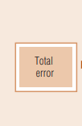
Errors in Survey Research
Sudha Bhagavatheeswaran, Department of Information Technology,
SIES College of Arts, Science & Commerce (Autonomous)

Slide 4
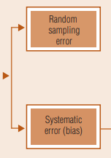
Errors in Survey Research
Sudha Bhagavatheeswaran, Department of Information Technology,
SIES College of Arts, Science & Commerce (Autonomous)

Slide 5
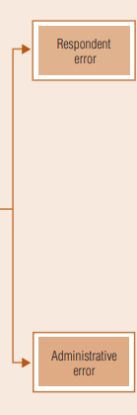
Errors in Survey Research
Sudha Bhagavatheeswaran, Department of Information Technology,
SIES College of Arts, Science & Commerce (Autonomous)

Slide 6
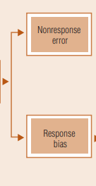
Errors in Survey Research
Sudha Bhagavatheeswaran, Department of Information Technology,
SIES College of Arts, Science & Commerce (Autonomous)

Slide 7
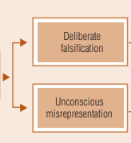
Errors in Survey Research
Sudha Bhagavatheeswaran, Department of Information Technology,
SIES College of Arts, Science & Commerce (Autonomous)

Slide 8
Errors in Survey Research
Sudha Bhagavatheeswaran, Department of Information Technology,
SIES College of Arts, Science & Commerce (Autonomous)

Slide 9
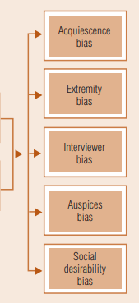

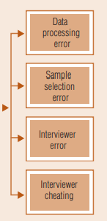
Errors in Survey Research
Sudha Bhagavatheeswaran, Department of Information Technology,
SIES College of Arts, Science & Commerce (Autonomous)

Slide 10
Questionaire
STRUCTURED / UNSTRUCTURED
STRUCTURED / UNSTRUCTURED
DISGUISED / UNDISGUISED
STRUCTURED - DISGUISED / STRUCTURED - UNISGUISED
UNSTRUCTURED - DISGUISED / UNSTRUCTURED - UNISGUISED
Sudha Bhagavatheeswaran, Department of Information Technology,
SIES College of Arts, Science & Commerce (Autonomous)

Slide 11
Temporal Classification
Cross – Sectional Studies :- A study in which various segments of a population are sampled and data are collected at a single moment in time
Longitudinal Studies:- A survey of respondents at different times, thus allowing analysis of response continuity and changes over time.
  Tracking Study :- A type of longitudinal study that uses successive samples to compare trends and identify changes in variables such as consumer satisfaction, brand image, or advertising awareness
  Consumer Panel :- A longitudinal survey of the same sample of individuals or households to record their attitudes, behavior, or purchasing habits over time
Sudha Bhagavatheeswaran, Department of Information Technology,
SIES College of Arts, Science & Commerce (Autonomous)

Slide 12
TQM and CSS
TQM - A business philosophy that emphasizes market-driven quality as a top organizational priority.
assure customers’ satisfaction with the quality of goods and services.
The level of quality is the degree to which a good or service truly is seen as good or bad
Every person, in every department, and at every level, has a customer.
The customer is anyone to whom an individual provides service, information, support, or product.
The customer may be another employee or department (internal) or outside the company (external).
Sudha Bhagavatheeswaran, Department of Information Technology,
SIES College of Arts, Science & Commerce (Autonomous)

Slide 13
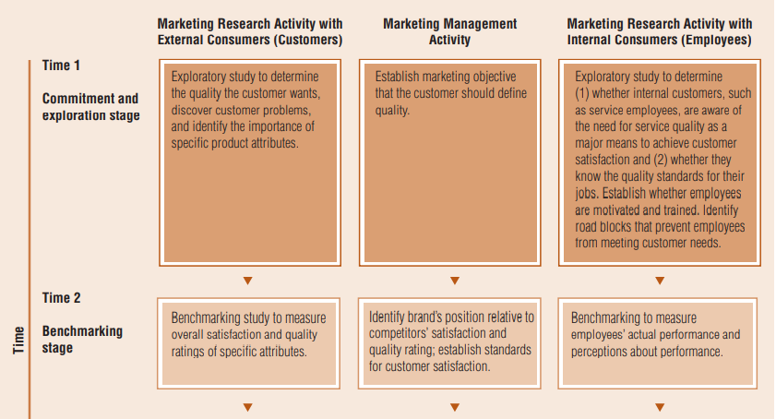
Implementing TQM – Survey research
Sudha Bhagavatheeswaran, Department of Information Technology,
SIES College of Arts, Science & Commerce (Autonomous)

Slide 14
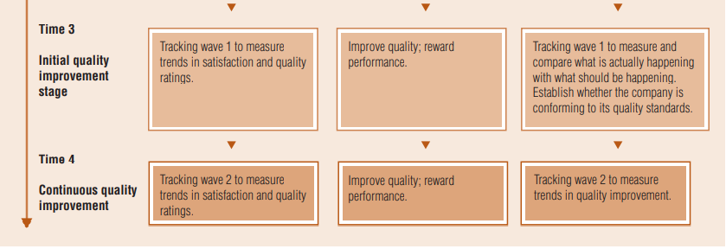
Implementing TQM – Survey research
Sudha Bhagavatheeswaran, Department of Information Technology,
SIES College of Arts, Science & Commerce (Autonomous)

Slide 15
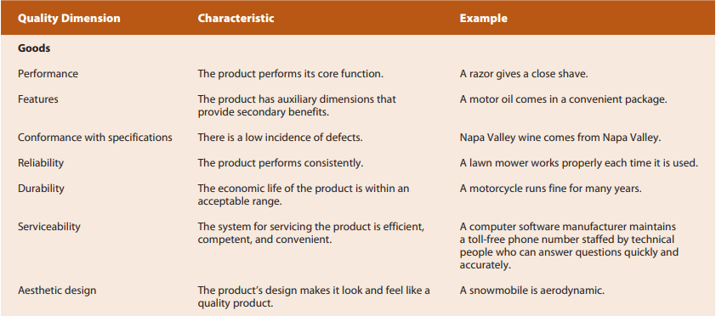
Quality Dimensions for Goods
Sudha Bhagavatheeswaran, Department of Information Technology,
SIES College of Arts, Science & Commerce (Autonomous)

Slide 16
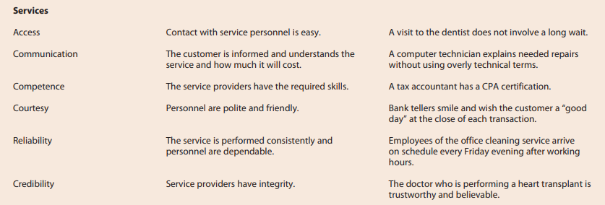
Quality Dimensions for Services
Sudha Bhagavatheeswaran, Department of Information Technology,
SIES College of Arts, Science & Commerce (Autonomous)

